Slide 1

Introduction to R
Alliance Bioversity International and CIAT, Cali, Colombia. January, 2025

Slide 2

What is R ?
It is an object-oriented programming language, focused on computation or statistical processing.
It is free and open source.
It integrates a wide variety of graphical and statistical techniques.
It is a very understandable programming language.

Slide 3
Why to use R
It is a tool that allows us to automate many processes
It is easy to understand and use
It has a large community of developers worldwide.
It is equipped with the most up-to-date statistical analysis techniques
And many more …

Slide 4

R Studio Desktop
It is an IDE or integrated development environment.
It is a program that integrates several functionalities oriented to facilitate the programming of routines.
It has a more developed graphical GUI interface.In most cases they are multiplatform.
By integrating all the tools in one place it makes our life easier.
We can download it from this link: https://www.rstudio.com/products/rstudio/download/#download

Slide 5
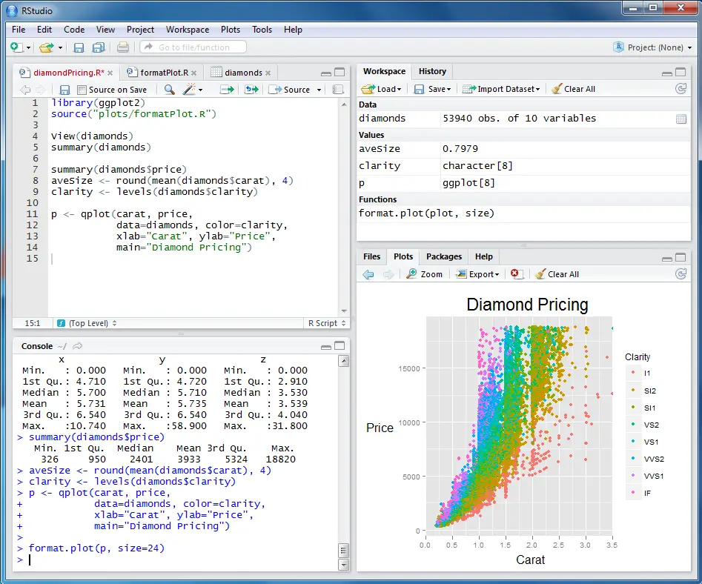
R Studio (GUI)
1
3
Script editor
Console/Terminal
Workspace
Graph viewer, library and help page
4
2

Slide 6
Algorithmic Thinking
What is an algorithm?
An ordered set of systematic operations to perform a calculation and find a solution to a type of problem.
Algorithmic thinking involves abstraction, modeling a problem, logical deduction, and synthesizing a solution leading to writing the correct algorithm.
Process
Input
Output

Slide 7
Exercise
Scenario:
First quarter sales totals of 4 stores in listed cities for 2024 are given. Calculate the annual sales total for each store.
Identify inputs.
Define the desired outcome.
Establish steps to process inputs and convert them into the desired outcomes.
 | Month
Sales points | January | February | March
cali | 3643 | 4652 | 2145
bogotá | 2011 | 4345 | 4708
medellín | 2820 | 1995 | 3273
cartagena | 4487 | 3574 | 4832
pasto | 3643 | 4652 | 2145

Slide 8
Solution
Inputs:
Table with monthly sales totals.
Rows contain city sales point records.
Columns contain monthly sales data.
Processing:
Sum rows and add the resulting value in the las column
Outputs:
Table with the sum of monthly sales for each salespoint.
 | Month
Sales points | January | February | March | Total
cali | 3643 | 4652 | 2145 | 10440
bogotá | 2011 | 4345 | 4708 | 11064
medellín | 2820 | 1995 | 3273 | 8088
cartagena | 4487 | 3574 | 4832 | 12893
What if i am intrested in total sales per month ?
Notes:
IT’S NOTEWORTHY THAT WE APPLIED AND OPERATION BY ROWS

Slide 9

Conceptos Básicos

Slide 10
What is an object/variable?
In object-oriented programming, an object is an empty container that can be filled with whatever the programmer decides.
In R, these containers are often referred to as variables due to the common use of the term in statistics.
Variables are composed of values, which have different types (Text, Numeric, Logical, Integer).
Variable names can not have spaces or special characters
Variable_name <- Value
Assignment symbol

Slide 11
Types of Values in R
Logical: TRUE, FALSE
Integers: 1, 2, 3, 4...
Real Numbers: 1.342, 3.45565, 0.0879985
Character/Text: “string,” “text”
Missing Values: NA
Non-calculable values: NaN
Very large/small values: Inf, -Inf
Null values: NULL
How to identify the type of values in a variable?
R provides tools to determine the types of values:
is(variable) and class(variable)These commands display the value type on the screen.

Slide 12
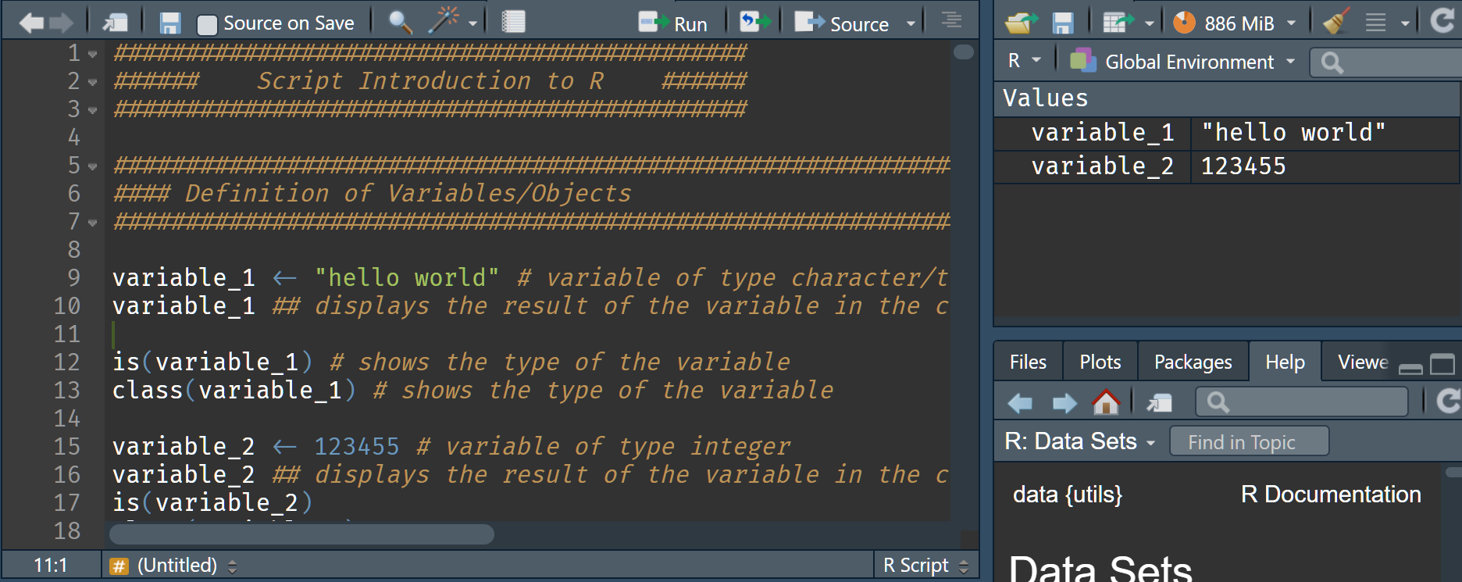

Slide 13
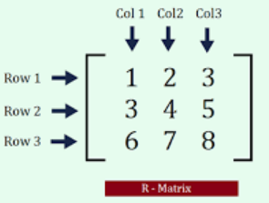
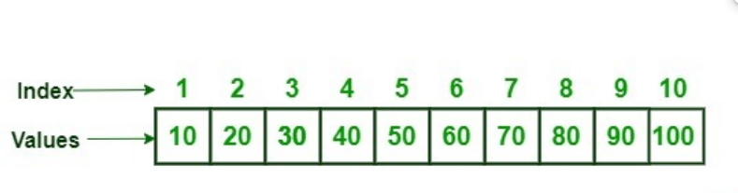
Vectors and Matrices – Basic Data Structures
Vectors:
Objects in programming often consist of multiple ordered and indexed values.
These are referred to as "Vectors" in R and are fundamental in the programming process.
Variables are often composed of vectors.
Matrices:
A collection of elements (numbers) arranged in rows and columns.
Each row and column is treated as a vector.
Matrices must have a fixed number of rows and columns.

Slide 14
Indexing
All objects/variables in R have a way to access elements.
Vectors: Elements are sequentially ordered, starting from position 1.
Access syntax: Variable[position].
Matrices: Access elements by specifying row and column indices:
Matrix[row number, column number] – extracts a single cell value.
Matrix[row number, ] – extracts the entire row.
Matrix[, column number] – extracts the entire column.

Slide 15
Exercice
Create a vector of length 10, containing the first alphabet letters.
Assign it to the variable “vec_exercice”
Get the letters in the position 3, 7 and 9 and print it in the console
Get the first 5 letters
Get the last 5 letters
Reverse the order of the “vec_exercice”

Slide 16
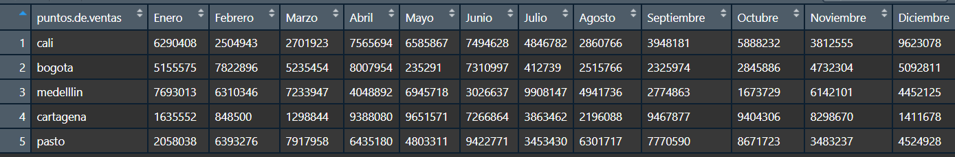
Data frames
They are similar to matrices.
They are organized by rows and columns.
Both rows and columns can be named.
They allow all types of values without affecting each other.
It is the most commonly used format.
It is easy to access all its elements.

Slide 17
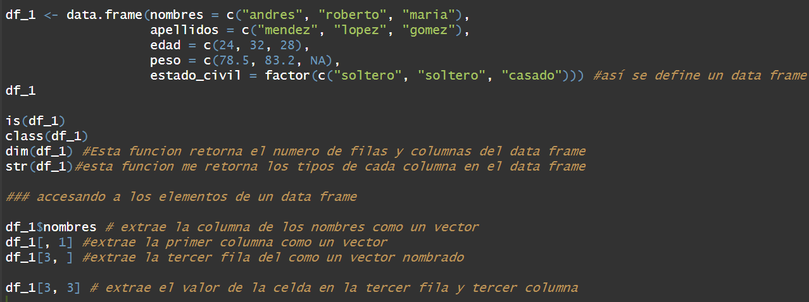

Slide 18
Filter by row
When managing and processing databases, it will always be necessary to apply filters.
R offers different ways to filter vectors, matrices, and data frames.
Vector[ logical condition]
Dataframe[logical condition, ]

Slide 19
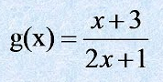
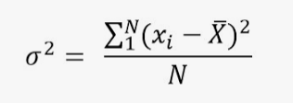
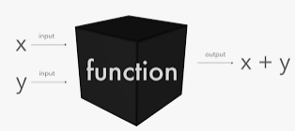
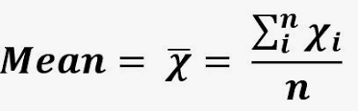
FUNCTIONS

Slide 20
What is a function ?
A function is a type of object.
It forms the basis of all programming in R.
A function is defined by a set of processes/algorithms to perform a specific task or calculation.
Functions require INPUT values, process them, and MUST return something.
Process
Input
Output

Slide 21
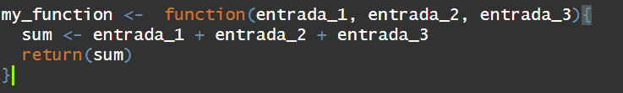
How are functions defined in R?
Functions have a specific structure:
A name must be assigned to the function.
Input values must be specified; these can be of any type or structure we've seen, such as data frames, vectors, matrices, etc.
The function must take the input values and perform some type of operation based on them.
Finally, it must return at least one object, which can be of any type.
1
2
3
4

Slide 22
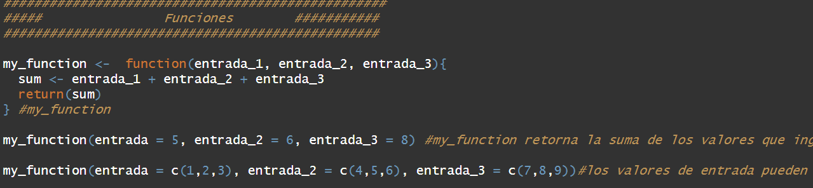

Slide 23
Function | Description
mean() | Calculates the arithmetic mean of a numeric vector.
sum() | Returns the sum of all elements in a vector or array.
length() | Returns the number of elements in a vector or list.
head() | Displays the first few rows of a data frame or the first elements of a vector.
tail() | Displays the last few rows of a data frame or the last elements of a vector.
seq() | Generates a sequence of numbers with a specified start, end, and step size.
sort() | Sorts a vector in ascending or descending order.
paste() | Concatenates strings with a specified separator.
which() | Identifies the indices of elements in a vector that meet a given condition.
table() | Creates a frequency table of elements in a vector or factor.

Slide 24
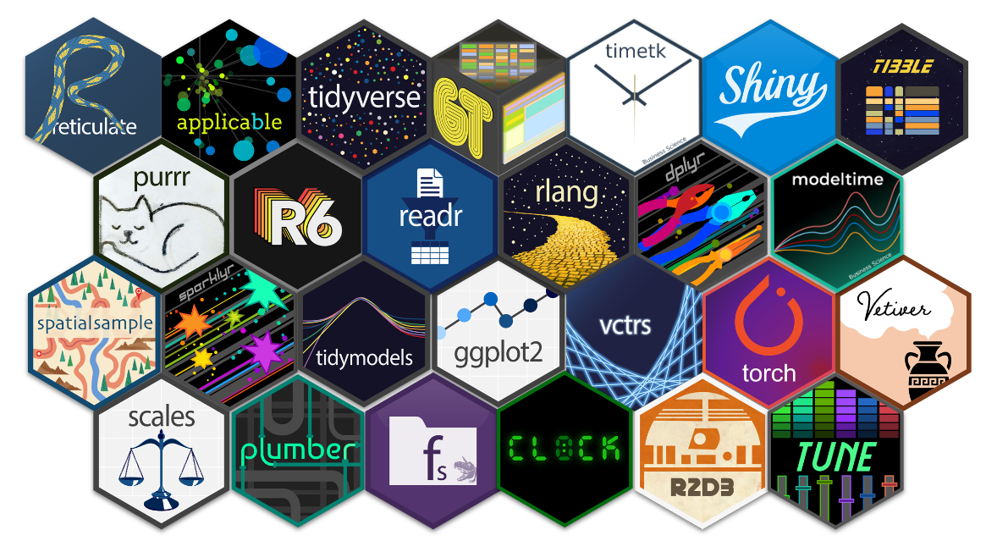
R libraries

Slide 25
What is a library?
Packages or libraries in R are a set of functions designed to solve many problems, mainly related to statistics.
By default, R comes with a series of installed packages called "base," which contain the basic functions for statistical processing.
When our operations or processes require more specialized functions that are not included in the "base" package, R provides the ability to install new packages.
Each package includes help documentation that explains the contents, functions, and other details.
Given the large community dedicated to developing new packages, R offers a massive catalog of packages.
Essentially, for almost anything we can think of or need to do, there is a package specifically designed to address those tasks (you just need to know how to find it).

Slide 26
How are packages installed in R?
Install.packages(“pkg name”)
This command Will download the package from CRAN repository
This command should be called just one time
Package Will be installed but is NOT called yet
library(pkg name unquoted)
This function Will load the package functions to the R sesión
It’s a Good practice to call load the libraries only at the start of the script.

Slide 27
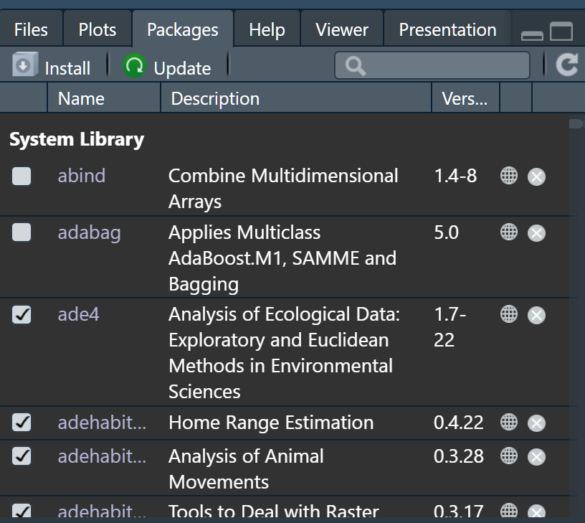
You can check which packages you have installed and which one are loaded to the R session

Slide 28
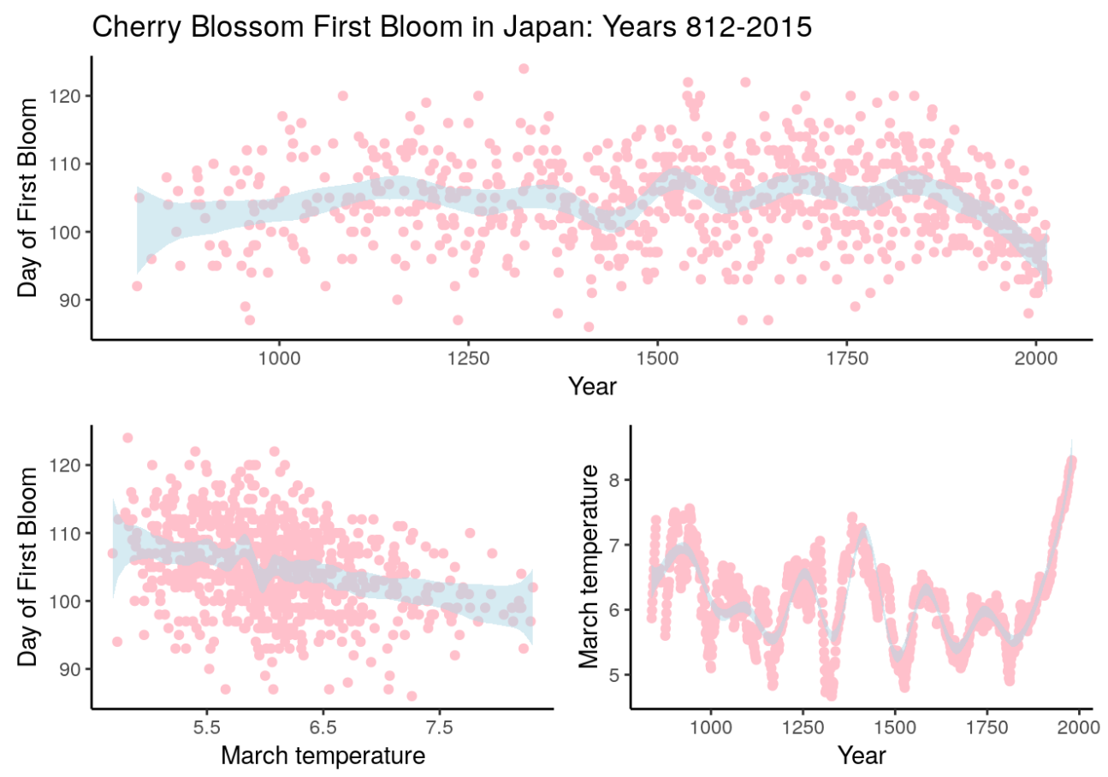
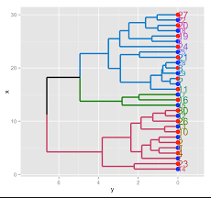
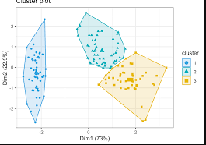
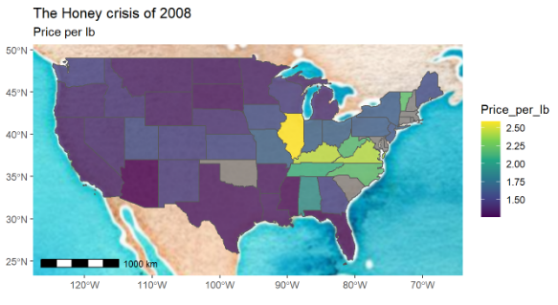
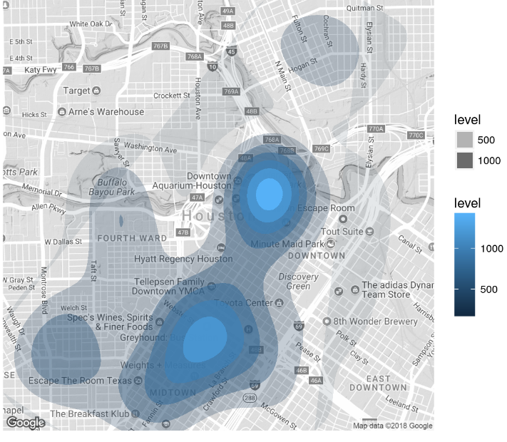

Slide 29
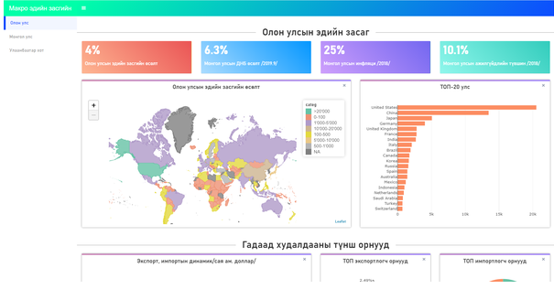
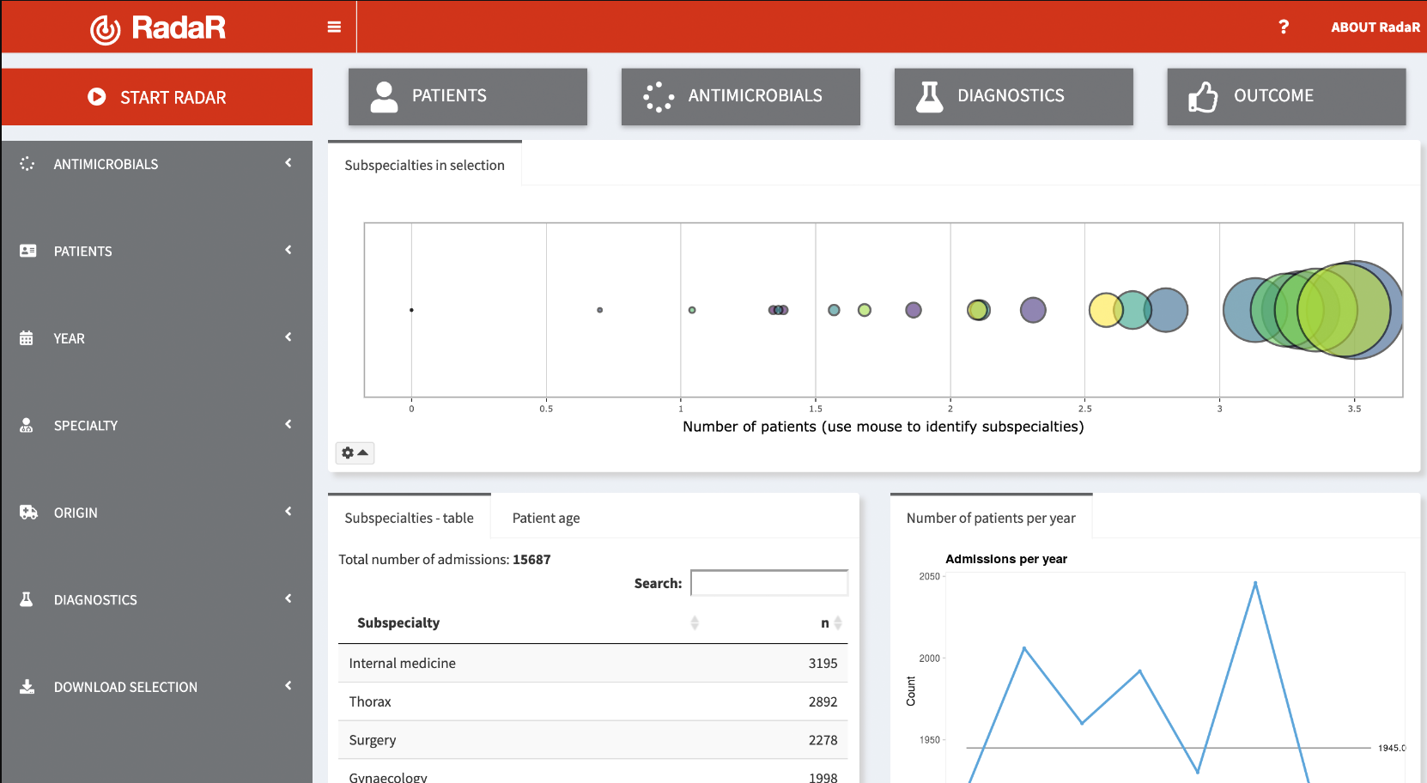


Slide 30
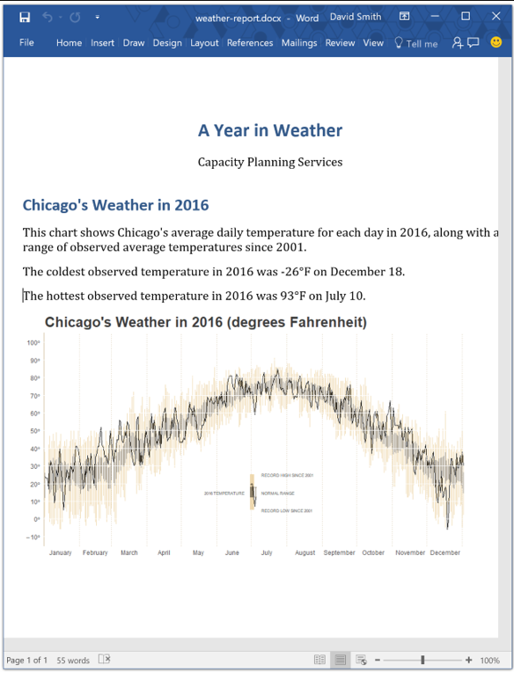


Slide 31
Questions?

